Slide 1
Fast Track your IT Career
With VMware Certifications

Slide 2
1
Introductions
2
Barrier's and Struggles of Certification
3
Understanding Certification Tracks
Agenda
4
Training and Exam Costs
5
Learning Materials and Resources
6
Strategies for Lab Setup
7
Wrap-Up and Q & A

Slide 3
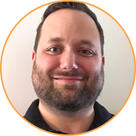
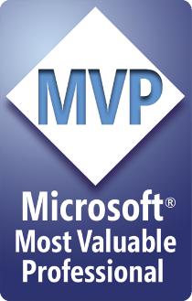
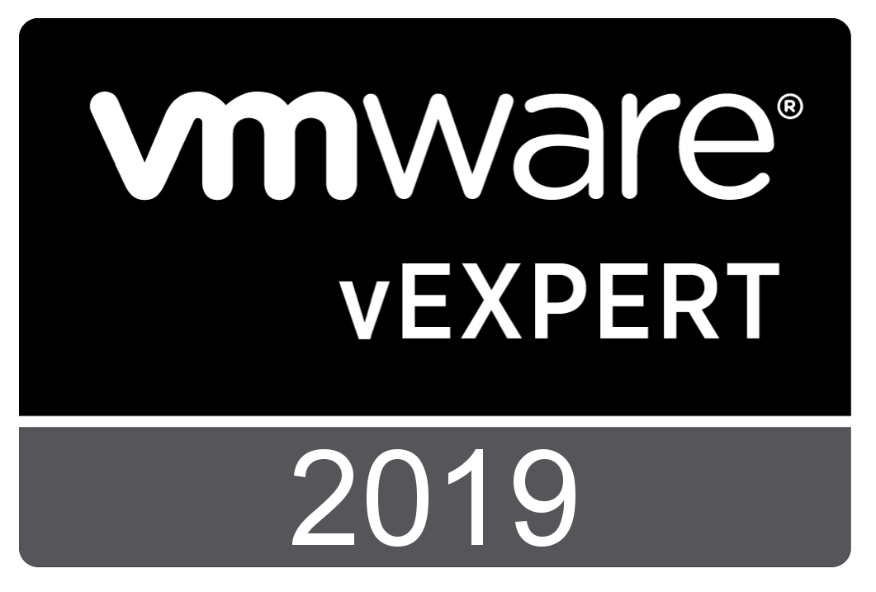


Meet your Host: Andy Syrewicze
Microsoft MVP (Cloud and Datacenter Management), VMware vExpert, & Technical Evangelist at Altaro
Technical Evangelist for Altaro Software
17+ Years providing technology solutions across several industry verticals
Historically have focused on the Windows Server Stack and VMware, with an emphasis on Hyper-V and vSphere Technologies
New Areas of Focus include Cloud and Containerization Technologies
@asyrewicze
www.altaro.com/hyper-v/ www.altaro.com/vmware/
www.altaro.com/msp-dojo/

Slide 4
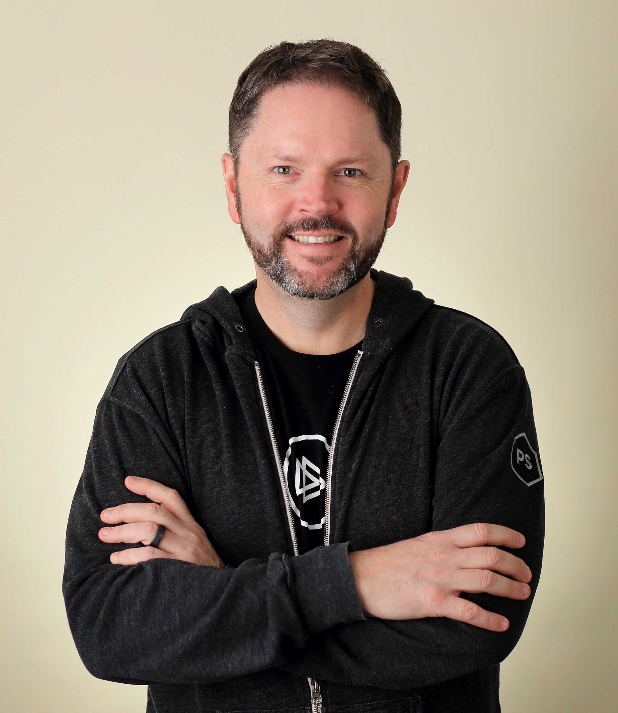
About your Speaker: Luke Orellana
Author Evangelist at Pluralsight, Teacher of Things, and Community Leader
20+ years of experience in the IT Pro Space
Works with technologies such as Exchange, VMware, Hyper-V, Azure, PowerShell, and Windows Server.
Main Focus: Automation, Infrastructure as Code, Azure, VMware, and Windows Server
@michaelbender
https://www.pluralsight.com/authors/michael-bender/
Notes:
Technical Evangelist for Altaro Software, providing community support, technical marketing and pre-sales expertise.
Prior to that I spent the last 14+ years providing technology solutions across several industry verticals including, education, fortune 500 manufacturing, healthcare and professional services working for MSPs and Internal IT Departments.
My focus has been in Virtualization, Cloud Services and the Microsoft Server Stack, with an emphasis on Hyper-V & VMware and interacting with the IT community via blogs, social media and published writings.

Slide 5
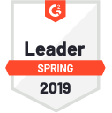
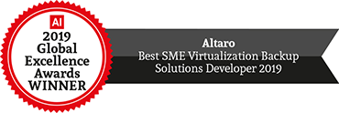

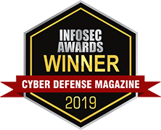
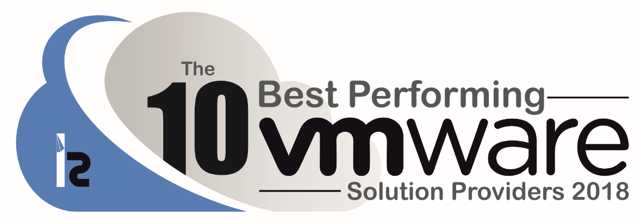
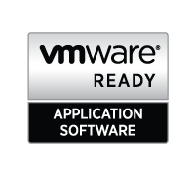

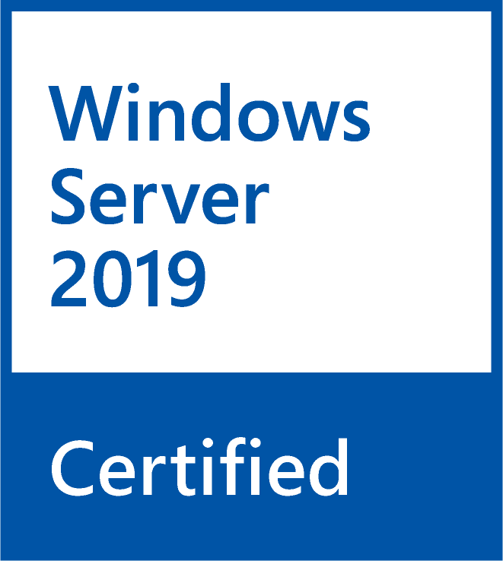
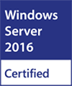
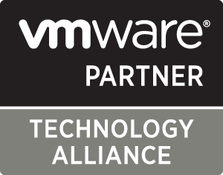
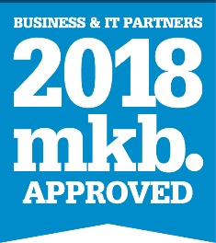



About Altaro Software
Altaro is a fast-growing developer of easy-to-use backup solutions for Managed Service Providers (MSPs), IT resellers and IT departments.
Virtual Backup trusted by 50,000+ Customers, 10,000+ Partners and 2,000+ MSPs worldwide.
Flagship product: Altaro VM Backup for Hyper-V and VMware – altaro.com/vm-backup
MSP program – altaro.com/msp

Slide 6
Barriers and Struggles of Certification

Slide 7

Poll & Discussion – What Are Your Barriers to Achieving Certification?

Slide 8
Understanding Certification Tracks

Slide 9

What is VMware VCP Certification?
VMware Certified Professional
Often Deemed the “Entry Level” certification for VM Professionals
Provides a baseline level of knowledge prior to certification branches
VCA Exists underneath, but targets a different audience
Considered to be one of the most sought after virtualization certifications on the market today

Slide 10
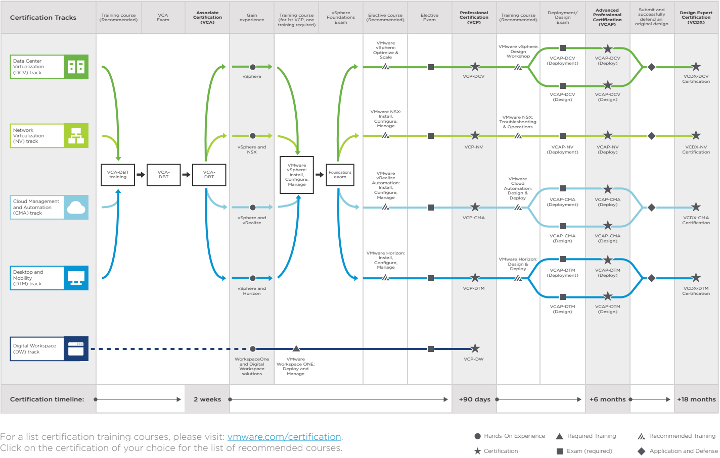

Slide 11
How do the VMware Certification Tracks Line Up With Career Positions?
DCV = System Admins
NV = NetOps Engineers
CMA = Cloud Administrators
DTM = Endpoint Mgmt. Administrators
DW = Endpoint Mgmt. Administrators

Slide 12
How do the VMware Certification Designations Line Up With Career Positions?
VCA = Sales/Marketing & Junior Admins
VCP = Mid-Level Administrators
VCAP = Senior Administrators
VCDX = Solution Architects

Slide 13
Training and Exam Costs

Slide 14
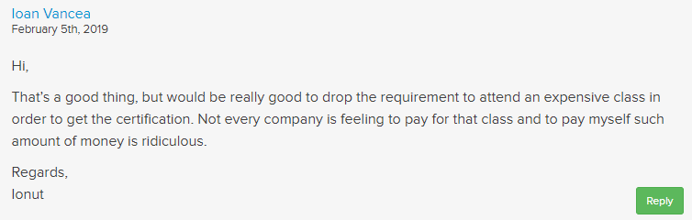
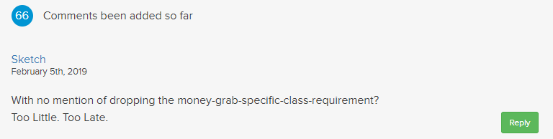

VMware VCP Certification Requirements
It’s more than just an exam!
For first time VCPs, you MUST attend a certified training course ($4250)
Sit for and pass the VCP Foundations Exam ($125)
Chose an elective path
Sit for and pass the associated VCP certification for the elective path ($250)

Slide 15
Any Alternatives to Paying for the Course Requirement?
Pay Out of Pocket
Sponsored by Employer
Local University
3rd Party Discount
Sadly there are few options…..

Slide 16
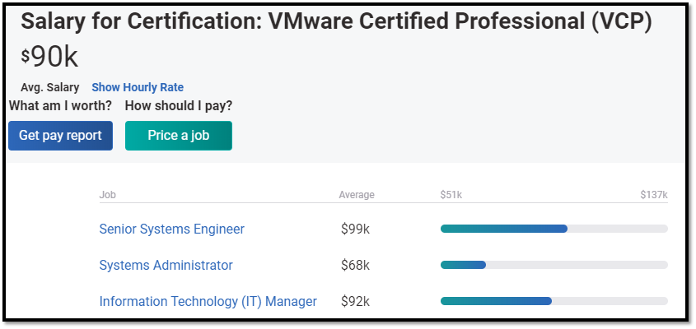
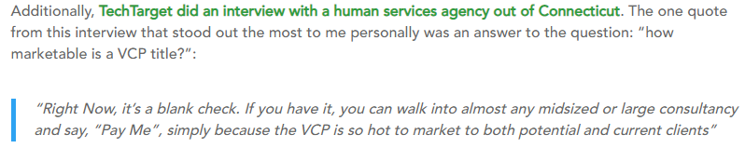
So is it worth it?
Short answer is yes! - https://www.altaro.com/vmware/certifications/
Increased Job Prospects
Increased Pay
Gives you the knowledge to reach bigger and better things
Once you have it you’re “in the club”
Recertification requirements have been relaxed, so re-cert costs are negligible

Slide 17
Learning Materials and Resources

Slide 18
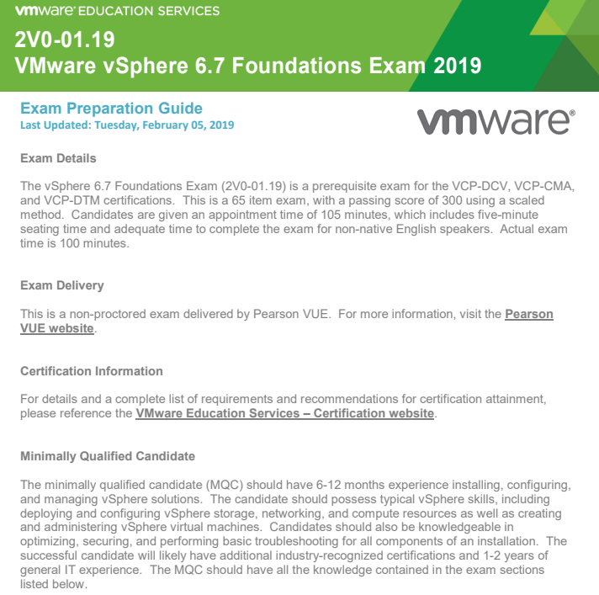
Exam Blueprints
Exam Blueprints provide:
Exam Information
Applicable Certifications
Candidate Recommendations
Topic Areas
KB References
https://www.vmware.com/education-services/certification.html

Slide 19
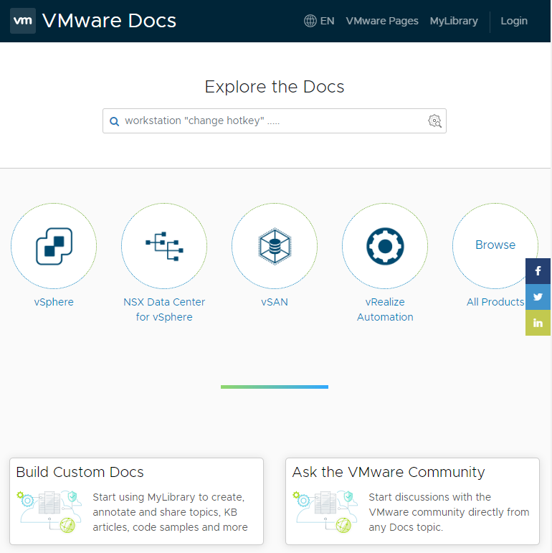
Official Documentation
Useful with Caveats
Highly Detailed
Tons of Information on All things VMware
Often too much info
Difficult to search through for specifics at times
https://docs.vmware.com

Slide 20


VMware Labs - Demo

Slide 21
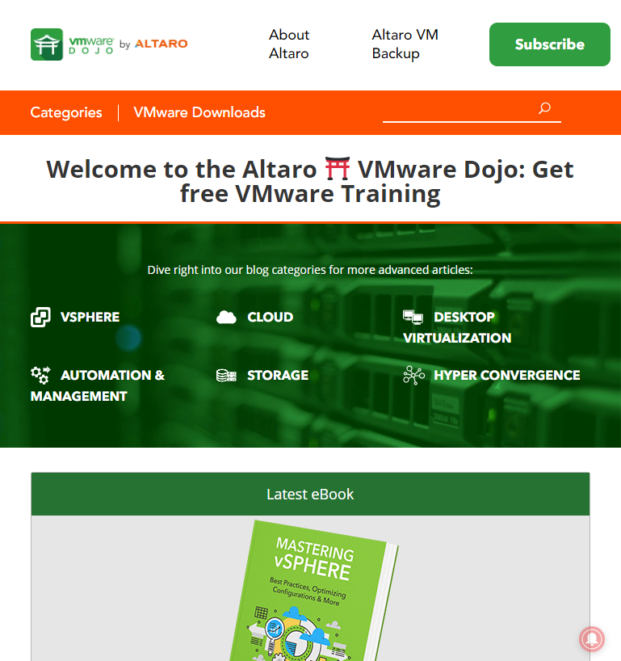
Altaro VMware Dojo
More Task and Use-Case Driven
Task Driven Blog Content
Mixed Video and eBook Content
Access to Webinars (Such as this one)
Expert Authors to interact with
You can have a voice in the content!
https://www.altaro.com/vmware

Slide 22


Other Learning Methods
Training Books
Classroom Training
Hands-On Experience
Teach what you know!
Become an Advocate of the Technology
https://dojoforums.altaro.com

Slide 23
Strategies for Lab Setup

Slide 24
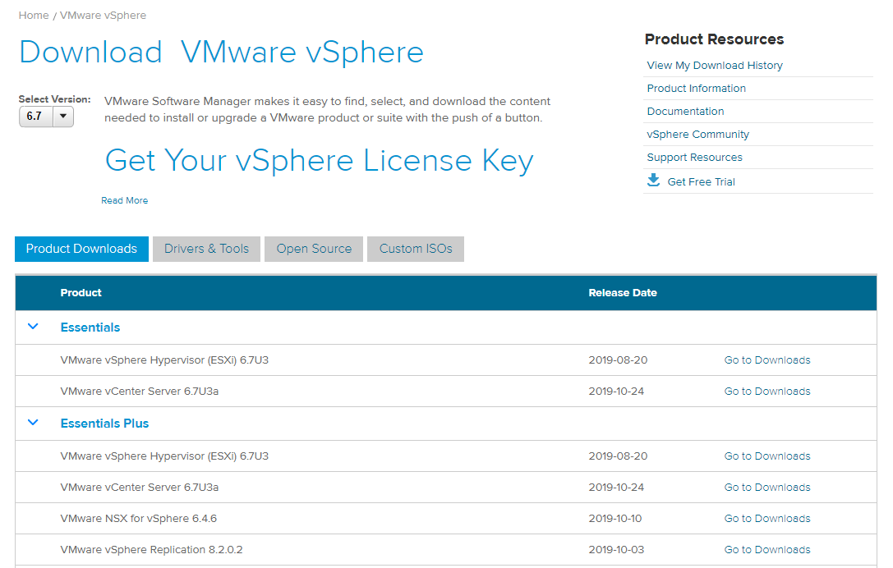
Where to Get Media?
It’s….. complicated
Free Trial
Trial Lasts for Varying Periods

Slide 25

Home Lab Tips
Don’t Install Just the Basics
Shoot for 3 Nodes Minimum
Spec for and setup VSAN
Layer 3 Switch is Recommended
Officially Supported Hardware not needed, but you need to make sure ESXi can run
This Photo by Unknown Author is licensed under CC BY

Slide 26
Other Tips and Advice

Slide 27

Tips for Exam Day

Slide 28

Be a Life Long Learner…..

Slide 29
Wrap-Up and Q & A

Slide 30
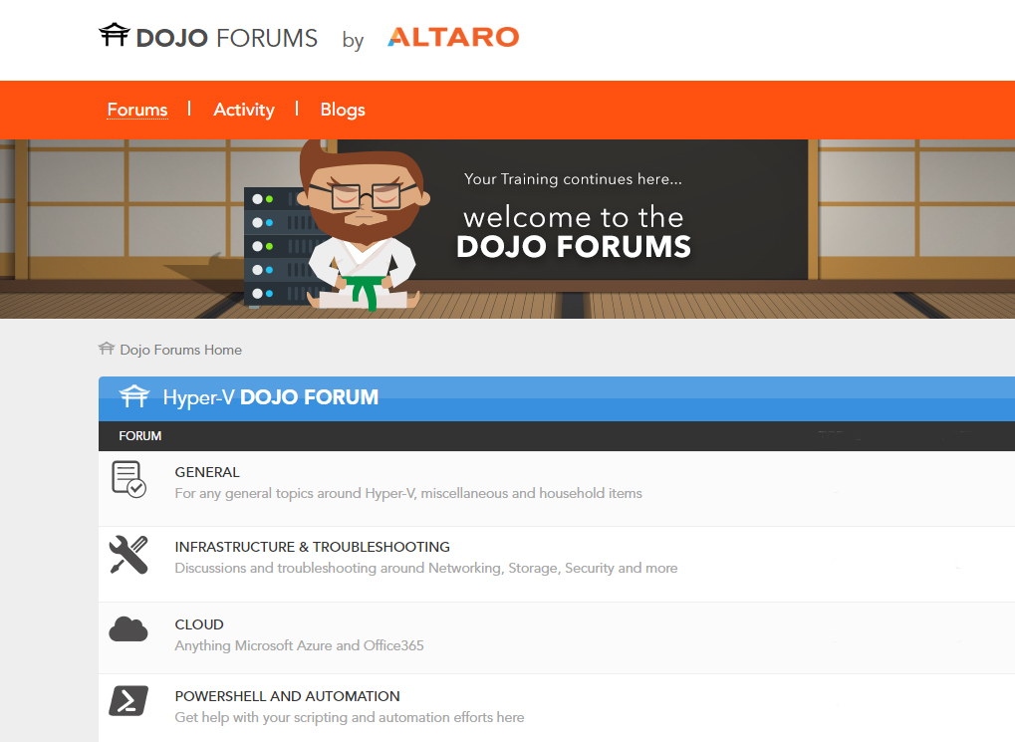
Dojo Forums by Altaro
New Forums are Live!
Hyper-V Forums are Available!
VMware and MSP Forums to Follow!
https://dojoforums.altaro.com

Slide 31
Poll & Discussion – What Certification Track is Most Appealing?

Slide 32
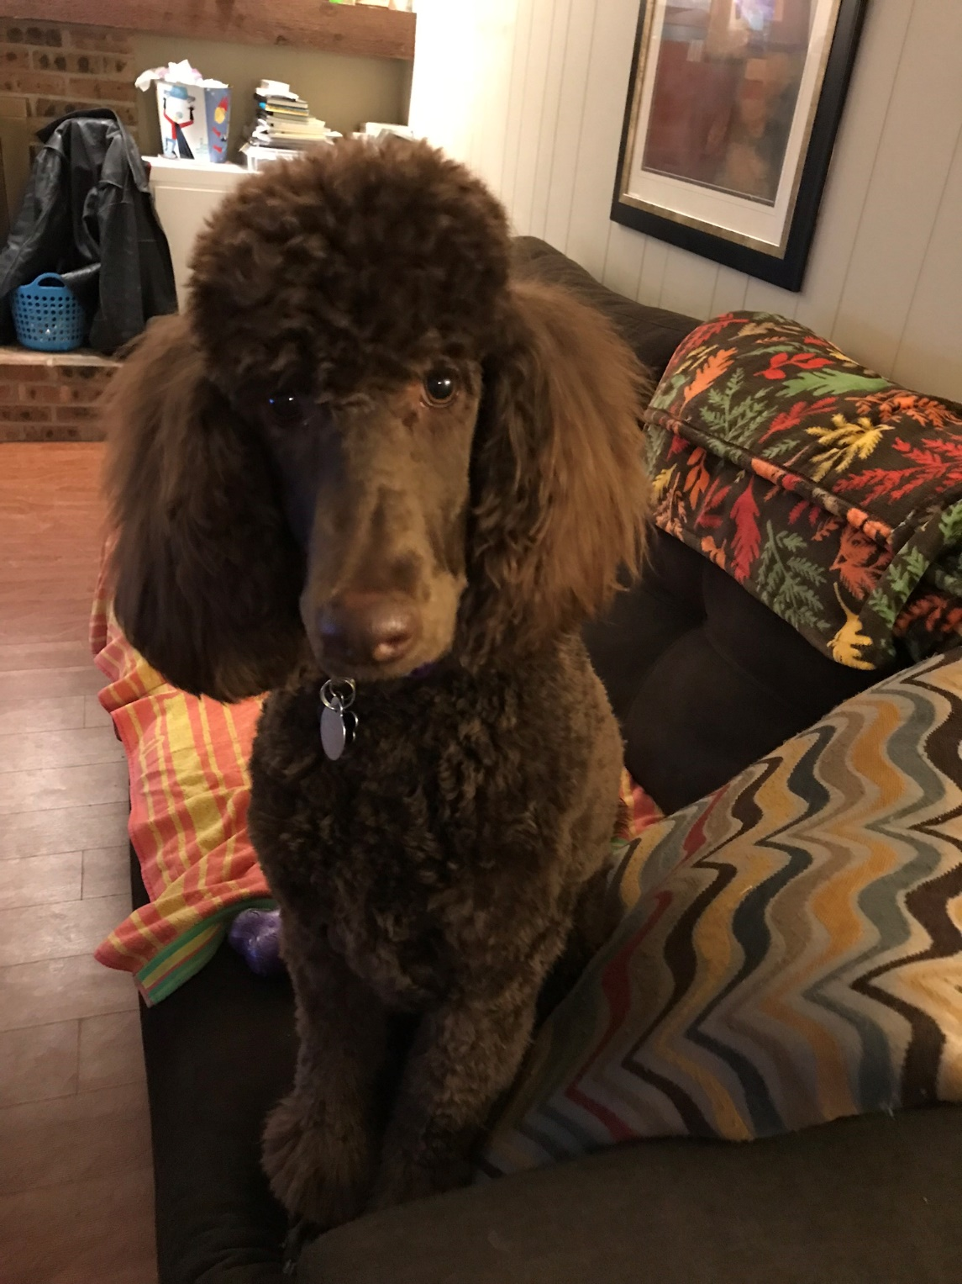
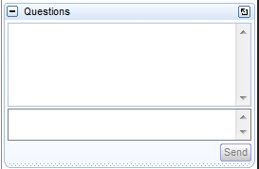
Polls, Final Q&A, and another chance for you to provide input!
Make your voice heard!
Have Questions or input of your own? Use the “Questions” box in GoToWebinar to join the conversation!
You Haz Question?

Slide 33




Get more educational content from Altaro
Thanks for Attending!
www.altaro.com/msp-dojo/
www.altaro.com/hyper-v/
www.altaro.com/vmware/
facebook.com/AltaroSoftware
@AltaroSoftware
linkedin.com/company/altaro
youtube.com/c/AltaroSoftware

